Slide 1
DTSA-5301 Final Project Presentation
How do shooting victim demographics change over time?

Slide 2

Data Source

Slide 3
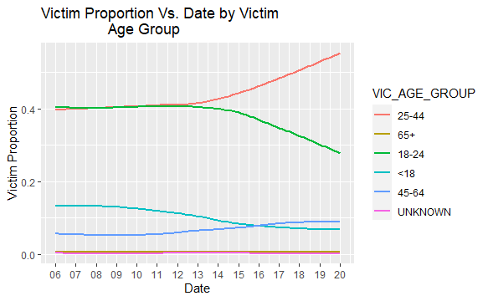
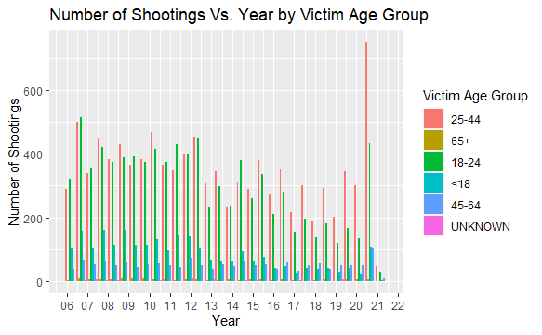
Shootings by Victim Age Group

Slide 4
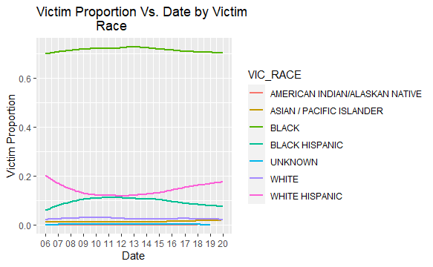
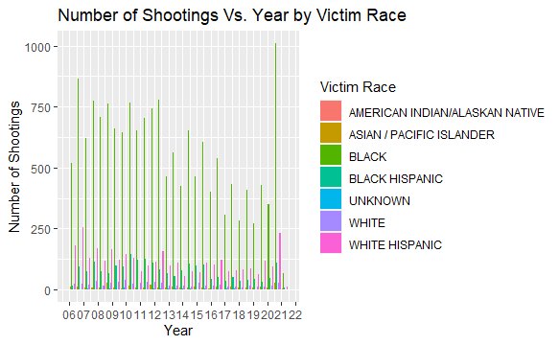
Shootings by Victim Race

Slide 5
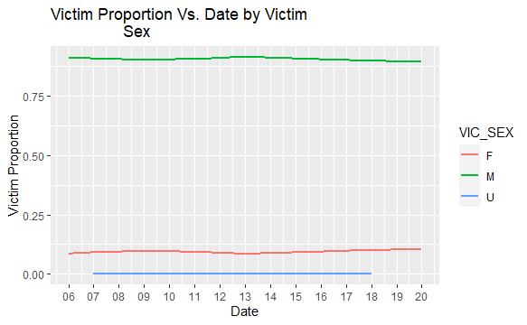
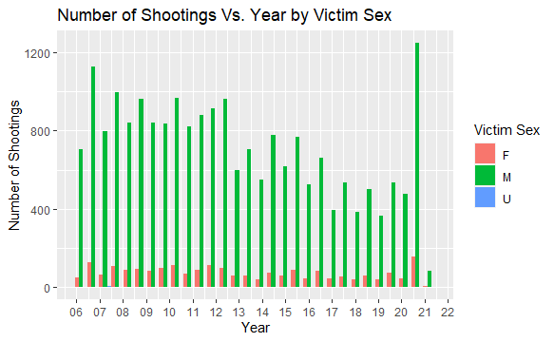
Shootings by Victim Sex

Slide 6
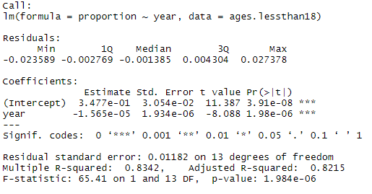
Models by Age, 18--

Slide 7
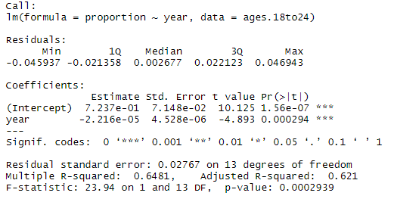
Models by Age, 18-24

Slide 8
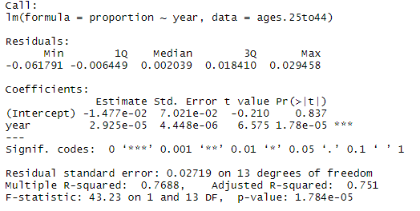
Models by Age, 25-44

Slide 9
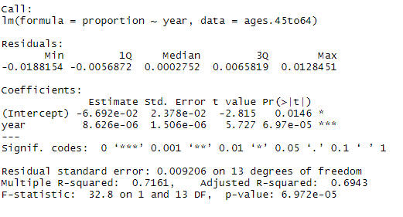
Models by Age, 45-64

Slide 10
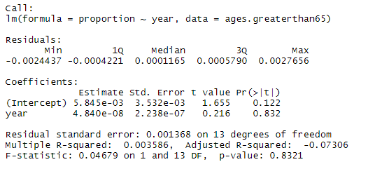
Models by Age, 65++

Slide 11
Conclusions
Shooting victim age is increasing
Black Americans are much more likely to be subjected to gun violence than any other demographic
Men are much more likely than women to be subjected to gun violence
COVID is probably really bad for gun violence

Slide 12
Error Sources and Biases
Data inputted by NYPD, a historically racist organization
Stop and Frisk has been in effect since 2003
Bloomberg said, “I think we disproportionately stop whites too much and minorities too little.”
Data do not record incidents of police violence, which disproportionately affects minorities
Models may not be accurate representations of reality due to quarantine

Slide 13
Bibliography and GitHub
Bib:
Data Source
"Bloomberg: police stop minorities 'too little'". USA Today. Associated Press. June 28, 2013. Retrieved February 11, 2020.
GitHub:
https://github.com/firstrider55/NYPD_Shooting_Project

